Slide 1
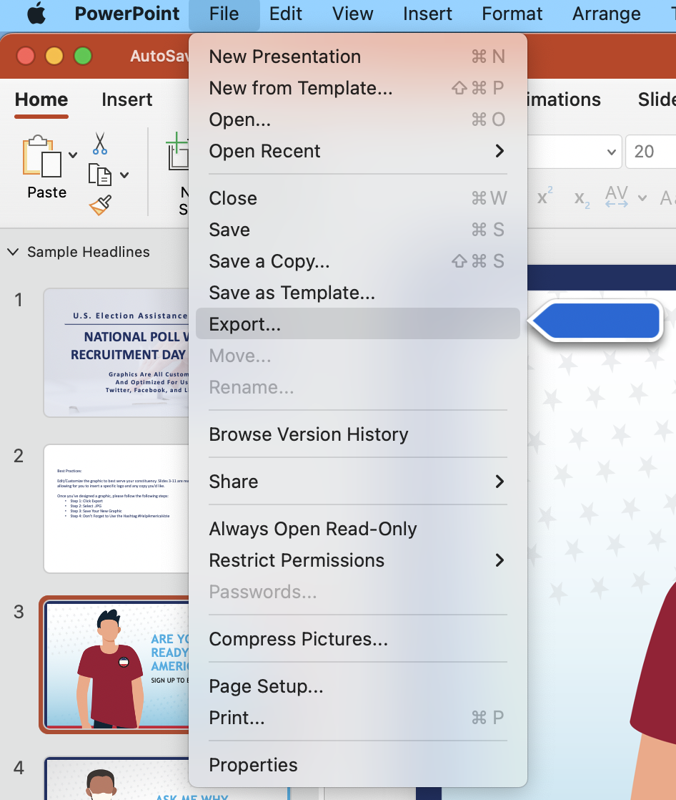
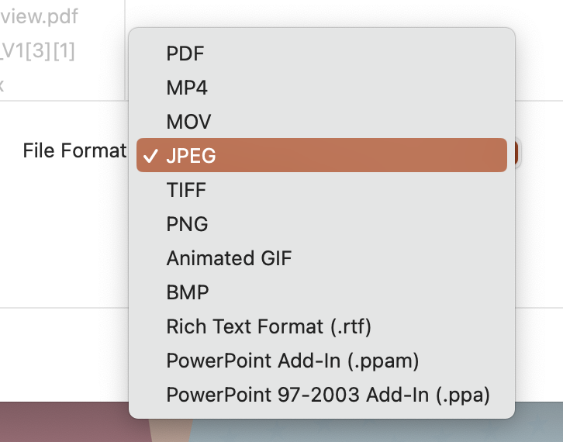
For Mac Users: Best Practices: Step-by-Step Guide To Customizable Graphics
Edit/Customize the graphic to best serve your constituency. There are two versions of each graphic, one that is ready to publish and one that is customizable – allowing for you to insert a specific logo and any copy you’d like.
Step 1
Step 2
Once you’ve designed a graphic, please follow the following steps:
Step 1: Click File, then Export
Step 2: Select .JPG
Step 3: Save Your New Graphic
Step 4: Don’t Forget to Use the Hashtag #HelpAmericaVote

Slide 2
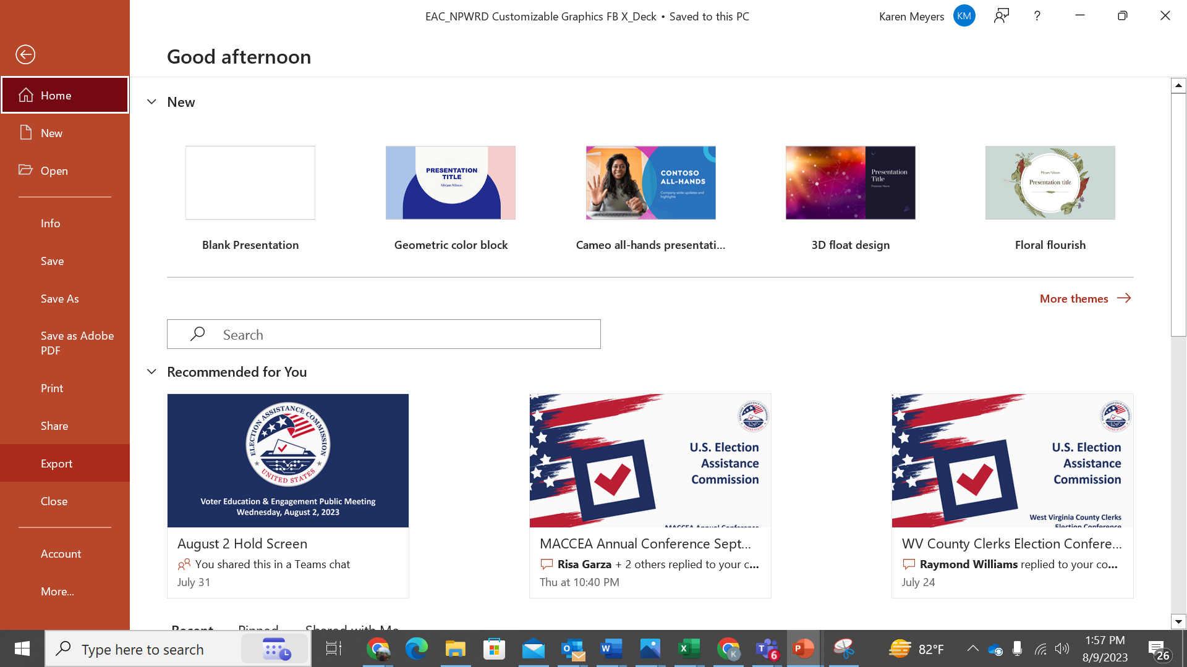
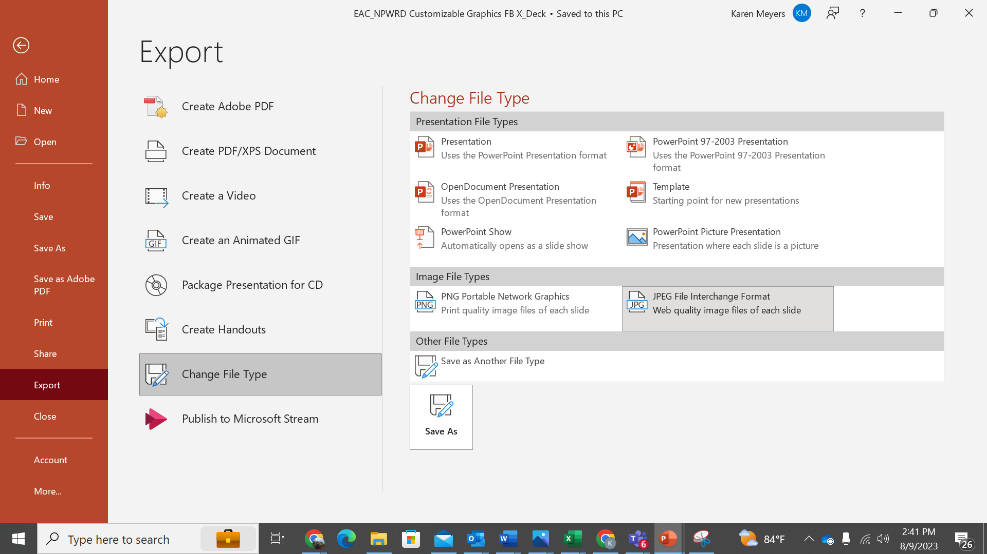
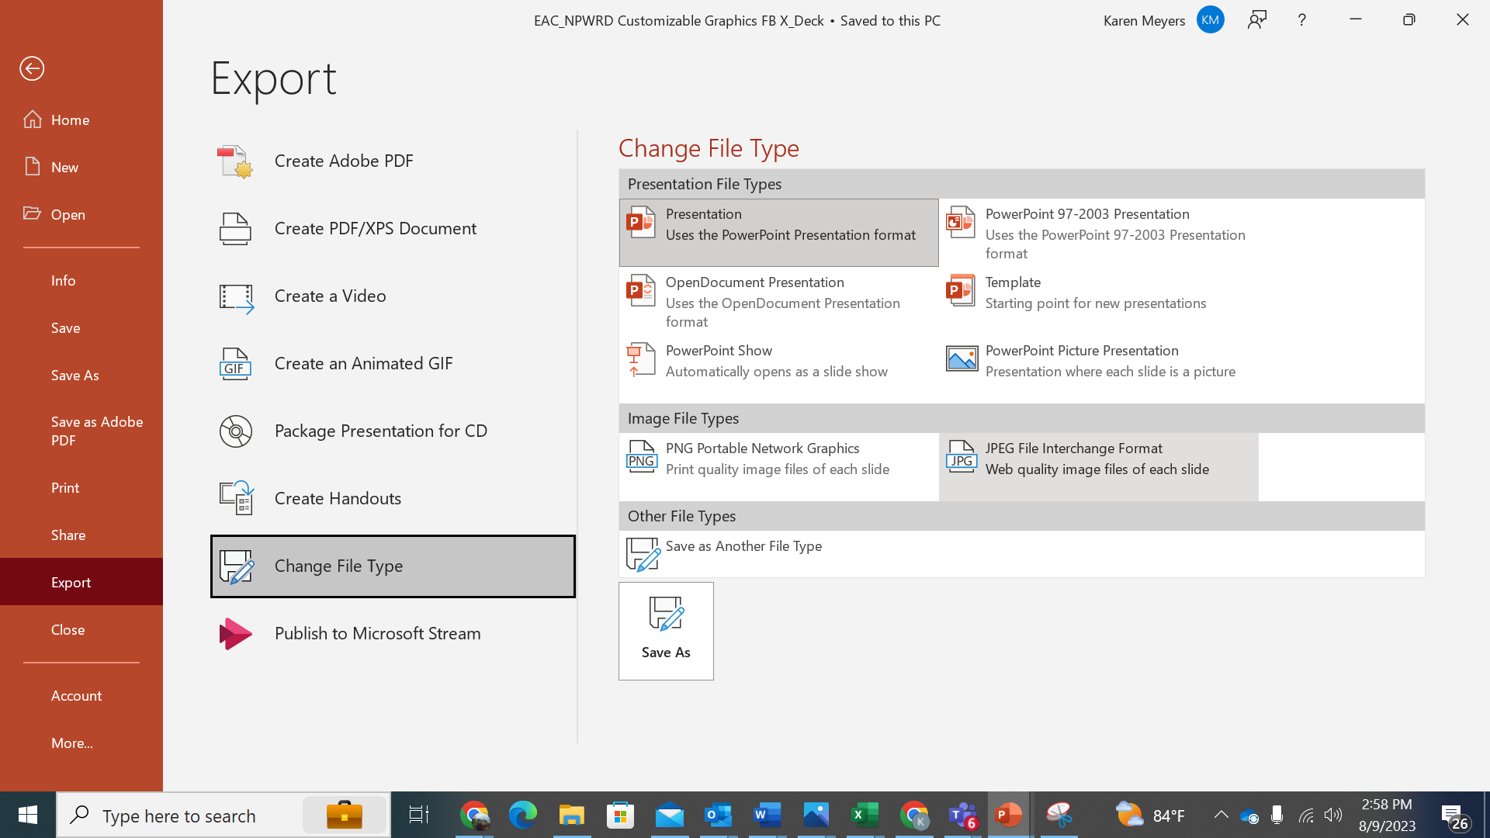
For Windows Users: Best Practices: Step-by-Step Guide To Customizable Graphics
Edit/Customize the graphic to best serve your constituency. There are two versions of each graphic, one that is ready to publish and one that is customizable – allowing for you to insert a specific logo and any copy you’d like.
Step 1
Step 2
Step 3
Once you’ve designed a graphic, please follow the following steps:
Step 1: Click File, then Export
Step 2: Click Change File Type
Step 3: Under Image File Types, Select .JPG
Step 4: Save Your New Graphic
Step 5: Don’t Forget to Use the Hashtag #HelpAmericaVote

Slide 3


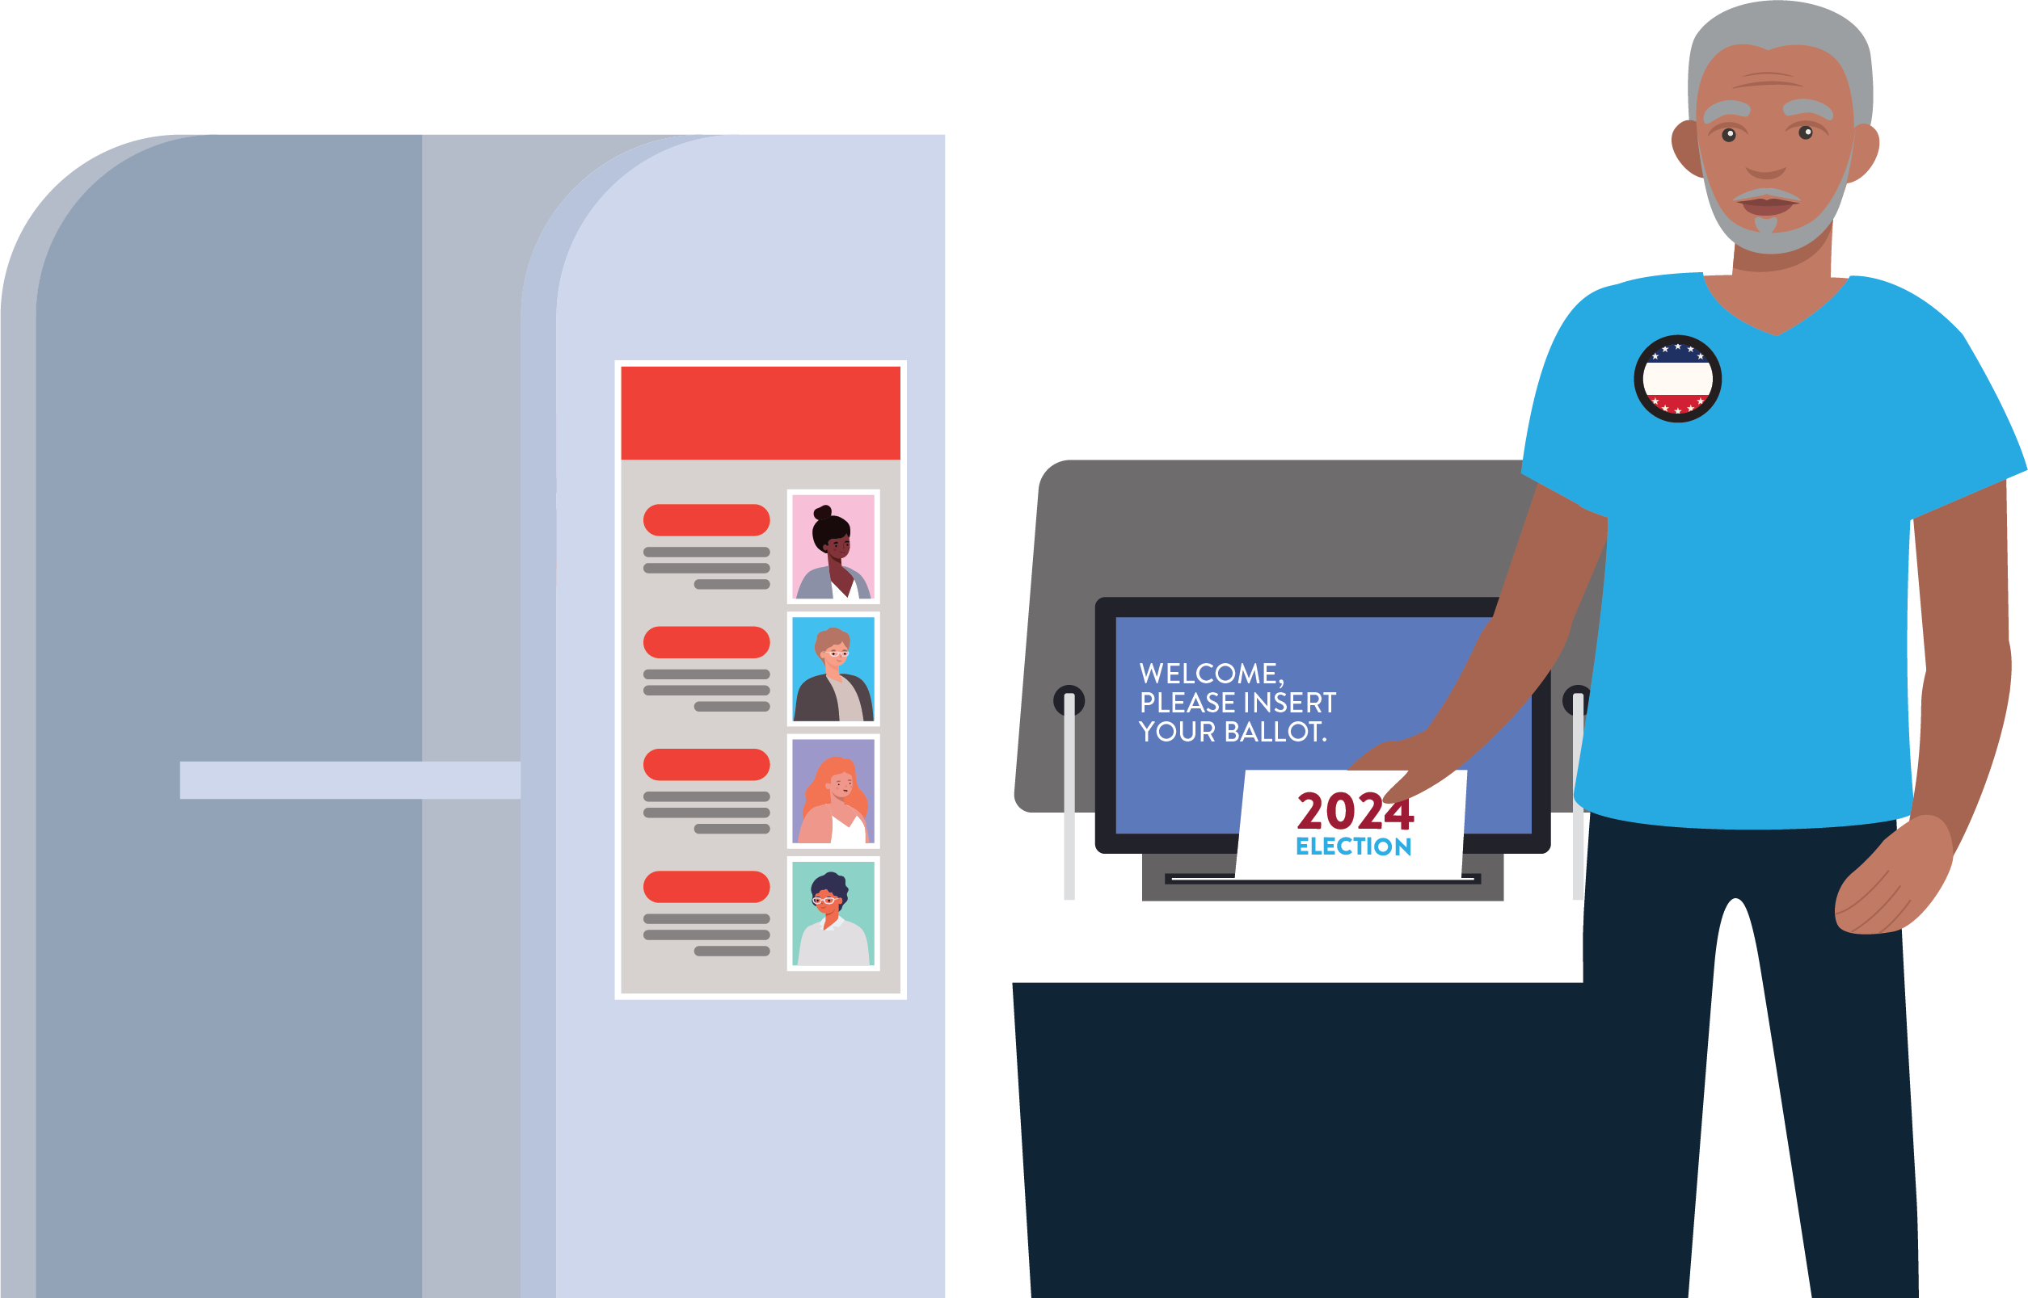
Your Text Goes Here
Your Subtext Goes Here
Your Logo Goes Here

Slide 4

Be Election Ready
Help America Vote

Slide 5

Your Text Goes Here
Your Subtext Goes Here
Your Logo Goes Here

Slide 6
Be Election Ready
Help America Vote

Slide 7

Your Text Goes Here
Your Subtext Goes Here
Your Logo Goes Here

Slide 8
Be Election Ready
Help America Vote

Slide 9
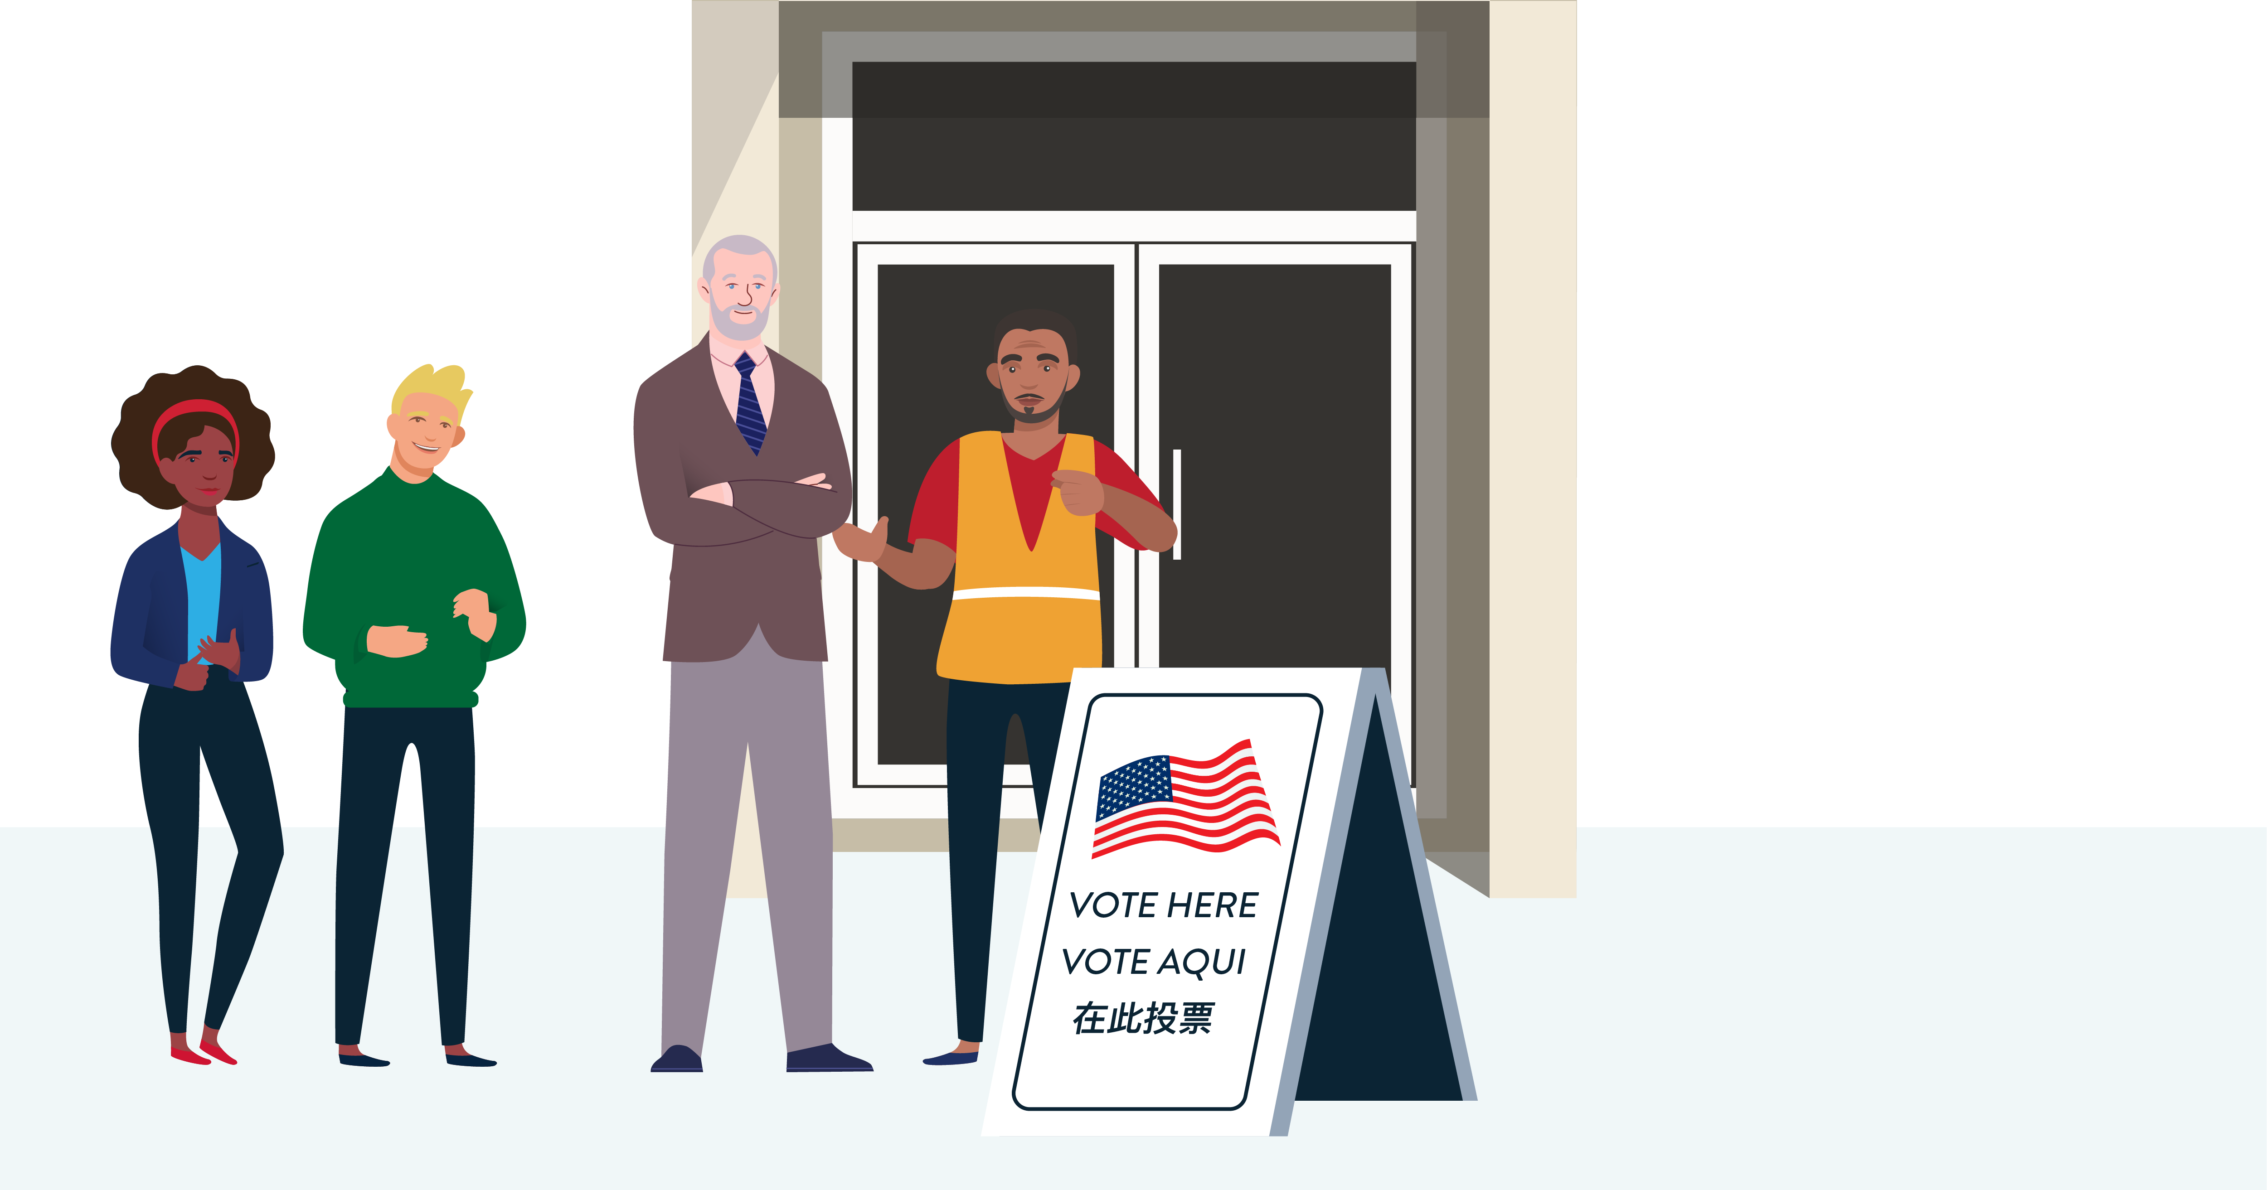
Your Text Goes Here
Your Subtext Goes Here
Your Logo Goes Here

Slide 10
Be Election Ready
Help America Vote

Slide 11

Your Text Goes Here
Your Subtext Goes Here
Your Logo Goes Here

Slide 12
Be Election Ready
Help America Vote

Slide 13

Your Text Goes Here
Your Subtext Goes Here
Your Logo Goes Here

Slide 14
Be Election Ready
Help America Vote

Slide 15

Your Text Goes Here
Your Subtext Goes Here
Your Logo Goes Here

Slide 16
Be Election Ready
Help America Vote

Slide 17

Your Text Goes Here
Your Subtext Goes Here
Your Logo Goes Here

Slide 18
Be Election Ready
Help America Vote

Slide 19

Your Text Goes Here
Your Subtext Goes Here
Your Logo Goes Here

Slide 20
Be Election Ready
Help America Vote

